Slide 1

Transforming the academic library to meet changing needs of research
Lessons learned At VU University Amsterdam
1
ARJAN SCHALKEN, A.F.SCHALKEN@VU.NL

Slide 2

A short introduction
Head of Academic Support (front office) and deputy library director
runner / trainer, photographer
www.linkedin.com/in/arjanschalken
VU University Amsterdam:
25.000 students
2500 academic staff
11 faculties
Shanghai ranking: nr. 100
www.vu.nl
Library:
Central service to all faculties
65 fte / wte
Budget: 10.000 kE
www.ub.vu.nl
2
VU University Library
Photo: More then luck: Optimize your chances
Photo: Prepare well but improvise when needed

Slide 3
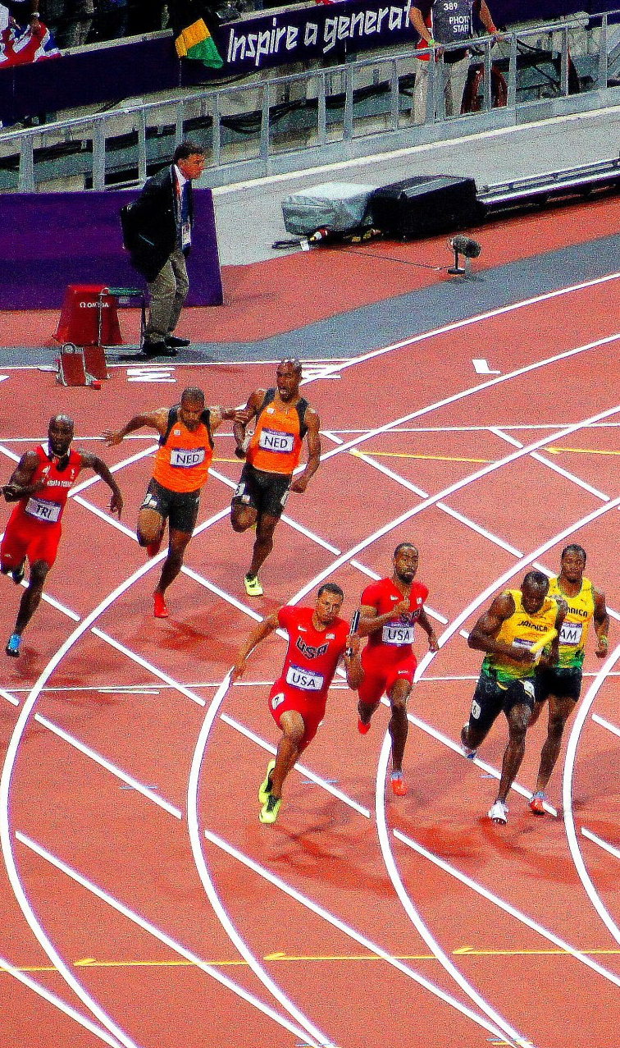
How it used to be: The library, a dedicated role in a linear research workflow
Characteristics knowledge dissemination:
Filtering by researcher, editor and library
Books en journals are dominating formats
Time gap discovery to knowledge consumption is often very long
Focus of libraries: optimization of access to published knowledge.
Open stack, Online
Study places, Information literacy
Digital, Big deals, PDA
Discovery tools
3
VU University Library
Photo: you need a strong (management) team

Slide 4

2010-2013: bad signs for the VU library (1)
Serial crisis hits hard: it’s all about the money
10% less lending of books each year
Physical library for many researchers invisible
Will open access or a ‘Spotify for acadamic content’ be the end of the libary as we know it?
And last but not least: reorganization at the VU University Amsterdam. Demand for 30% cuts in library staff.
4
VU University Library
Photo: there is always room for improvement but be proud of what you accomplish

Slide 5
2010-2013: bad signs for the VU library (2)
Strategy: compensating the deminishing impact of the library by adding other academic services
Focus on education
Audio Visual Centre and educational advisors become part of the library
Reorganization: focus on cutting costs = cutting services
No synergy library – audio visual centre and educational advisors
Reorganization plan: no support from board University, library staff and faculties
Library director leaves
5
VU University Library

Slide 6

Important management lessons learned
The truth about reorganizing and money:
When you focus on money: you never have enough.
When you focus on goals and priorities you always have enough.
You need to know in what direction research and education is developing and what (new) needs occur.
6
VU University Library
Photo: experience is more important then luck and experience starts with practice

Slide 7

What do researchers need?
The research process is becoming more and more complex:
Digital (big data, digital humanities)
Networked
Multidisciplinary
International
Competitive
Demand for better governance
Demand for transparency
Analytics: measuring output and impact
Faster sharing of knowledge (social media, DIY)
Managing and storing research output (RIS)
Etc.
Photo: you need to know what the situation on the ground is (communication is very important but complex so do it often en check the results)
7
VU University Library

Slide 8

The library can Flourish, even in rough conditions
The research process is becoming more and more complex:
Digital (big data, digital humanities)
Networked
Multidisciplinary
International
Competitive
Demand for better governance
Demand for transparency
Analytics: measuring output and impact
Faster sharing of knowledge (social media, DIY)
Managing and storing research output (RIS)
Etc.
8
VU University Library
Photo: Know your strenght and you will grow

Slide 9
The library can Flourish, even in rough conditions
The research process is becoming more and more complex:
Digital (big data, digital humanities)
Networked
Multidisciplinary
International
Competitive
Demand for better governance
Demand for transparency
Analytics: measuring output and impact
Faster sharing of knowledge (social media, DIY)
Managing and storing research output (RIS)
Etc.
Storage
Copyright
Content management
Managing budgets
Digitization
Negotiations
with publishers
Metadata
Quality of content
Access to resources
Customer network
9
VU University Library
Photo: Know your strenght and you will grow

Slide 10
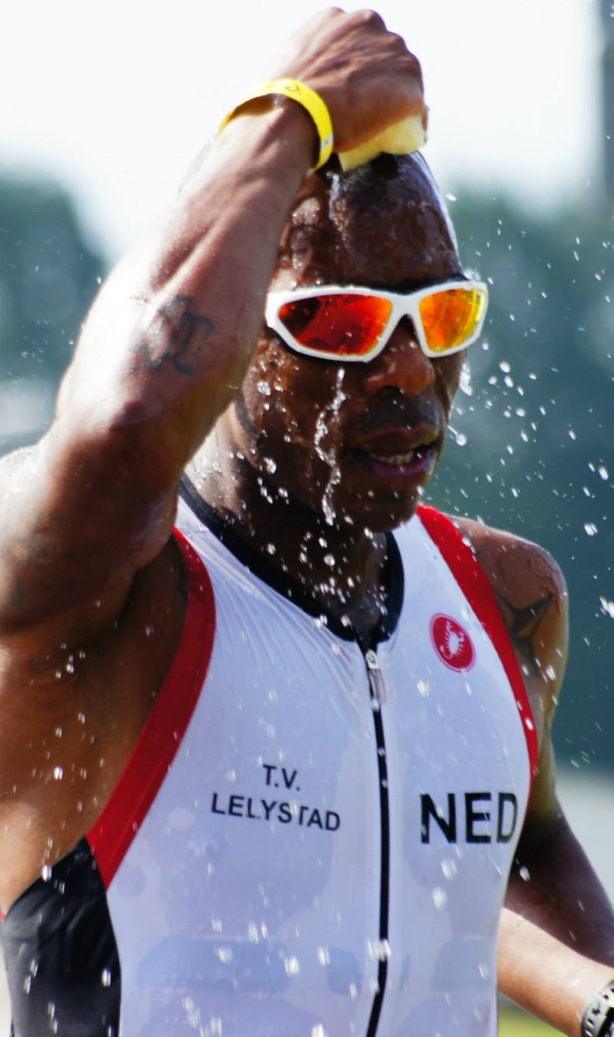
The library can flourish, even in rough conditions
New reorganization plan 2014
Mission: library is the manager of
academic content of the university
Extra efficiency in back office
Less service desks (longer opening hours)
Embedded librarians
Investing in research support
Most important enablers
New library System (WMS)
Research Data Management project
Project New RIS (PURE)
1 service desk instead of 4
Change in organization, roles, culture and services
Photo: you have to be at the right place at the right time
10
VU University Library

Slide 11

LIBRARY CULTURE
Redesign the game and rules
11
VU University Library

Slide 12
Strategy (1): customer first, then the service
Embedded librarians represent the library to researchers / faculties and work both at the library and the faculty
Most embedded librarians have 2 specialities: collection management / information literacy / research data management / open access / digital humanities plus general knowledge of other main services.
Library Management uses contacts with higher management of the university and faculties to position new services
Know your customers: Survey 101 innovations https://101innovations.wordpress.com/
Everybody has to invest in customer relations, also library management.
You are no ‘one man team’: you represent a team and you are part of a team.
Organization design has impact: around customers or services?
12
VU University Library

Slide 13
Strategy (2): work as a team
OPEN ACCESS
Before reorganization: 1 librarian responsible for open access.
Now: open access team. Expert copyright, librarian with research background, expert RIS, library management and recently also representatives of Academic Affairs and Communications
RESEARCH DATA MANAGEMENT
Close cooperation of research data service desk, data librarian, specialist digital humanities, innovation manager research. Knowledge transfer to embedded librarians. New librarians with research background add extra knowledge.
RESEARCH INTEGRITY
Management positions library as partner and potential project leader and service provider
Two projects: online R.I. course (Epigeum) for PHD students and pilot plagiarism tool for researchers (iThenticate).
13
VU University Library

Slide 14
Strategy (3): be a learning organization
Learning by doing
Sharing knowledge: expert sessions
Improving by sharing best practices instead of focusing on mistakes.
Stimulating informal contacts between staff, open culture, usage of Yammer (internal Twitter)
Better knowledge of customer needs
Better usage of statistics
Extra budget for training
New employees in team: focus on additional knowledge (research background)
There is no ‘one size fits all solution’: same goal but different ways to get there.
14
VU University Library

Slide 15
Strategy (4): play a role in strategic issues and deliver practical solutions – open acces
Open Access is about the balance of power between the academic world and publishers
Close cooperation Library director with both Chair of the University Board and Rector Magnificus
Road Show (by me) to all faculties: discussions with many researchers
Policy making (OA and RIS)
Open Access is about practical questions: you need to have answers
Copyright
Who pays for my APC (Article Processing Charges)
How can publishing in our repository (green open access) be made easy
Can you help us publishing our own open access journal
Organized National congress on open data
15
VU University Library

Slide 16
Strategy (4): play a role in strategic issues and deliver practical solutions – RDM
Research Data Management is about helping higher management with a university policy, cost efficient solutions and meeting external demands.
Research data managent project deliverable: a corporate policy on archiving research data including a recommendation of using the library for assistance.
Building a storage infrastructure with 3 solutions based on needs and requirements. Not 1 size fits all. High and low tech, high and low costs.
Research Data Management is about helping researchers
Building a user friendly research data infrastructure
RDM helpdesk (library) for tips, advise on privacy issues, help with data management plans, etc.
Connecting researchers (f.e.: open data congress).
16
VU University Library

Slide 17
Strategy (4): play a role in strategic issues and deliver practical solutions – impact factors and bibliometrics
Strategic discussions:
The importance and downsides of impact factors and the possibilities of alt metrics (also related to open access)
The impact on corporate identity discussions: what’s in a name…..
Strategic alliances: input to international office for network analysis
Helping researchers
Workshop ‘how to publish a world class paper’ for PHD students
Advise on impact factors
Bibliometric analysis as part of promotion process
17
VU University Library

Slide 18
Service scan: researchers ABOUT THE LIBRARY
ADVICE & SUPPORT TO RESEARCHERS | 2015 | 2014
Reachability | 3.9 | 3.7
Communicating | 4.0 | 4.0
Creative thinking | 4.0 | 3.5
Response time | 4.0 | 3.5
Taking initiative | 3.8 | 3.3
Level of expertise | 4.0 | 3.6
Usability of advice | 3.9 | 3.6
Quality of advice | 3.9 | 3.7
Scale 1-5
18
VU University Library

Slide 19

Questions, discussion
19
VU University Library
Notes:
All photo’s: Arjan Schalken

Slide 20
discussion
DUOS AND FEEDBACK
What is the biggest challenge?
What is the biggest opportunity?
What is the first stap you are going to make?
20
VU University Library

